Slide 1
How to install the Ubuntu Virtual Machine
Ted Kim

Slide 2
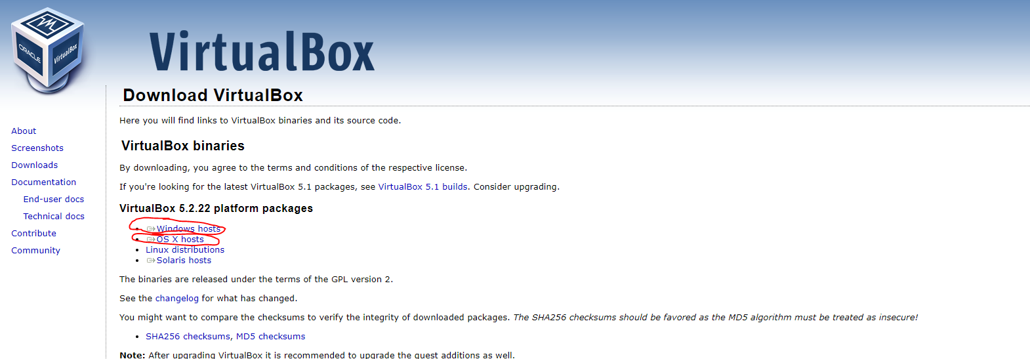
Step 1) Download the Oracle Virtual Box Software
https://www.virtualbox.org/wiki/Downloads
Download the one appropriate for your operating system
Windows computer -> Download Windows Host (1st red circle)
Apple/Mac Computer -> Download OS X Hosts (2nd red circle)
Below is a picture of what the download screen looks like/which links to click

Slide 3
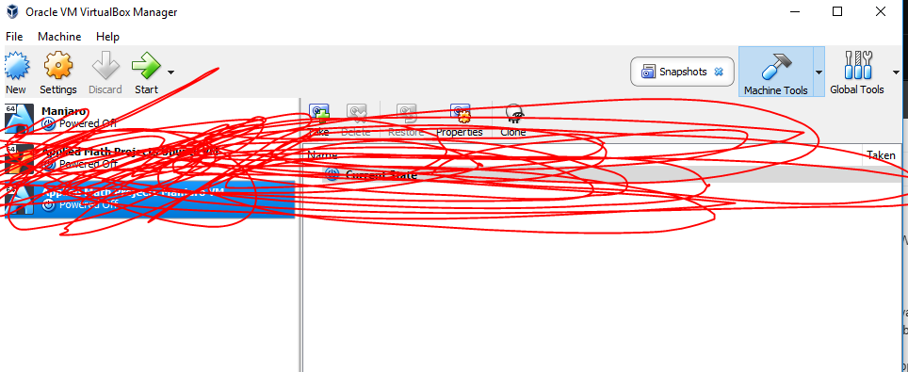
Step 2) Install the Virtual Box Software
Just press “NEXT” on everything and use the default settings
If you launch the program, it should look something like this (ignore the red lines):

Slide 4
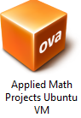
Step 3) Downloading the virtual Machine instance/Image
Download a .ZIP file from this link:
https://drive.google.com/file/d/1rcMFYaxL35n554v-gk7mWG3t79XUQShz/view
Does not contain viruses, I promise
It SHOULD take a long time – it’s a large file
The output from this unzipping process should be a “.ova” file
More specifically “Applied Math Projects Ubuntu VM.ova”

Slide 5
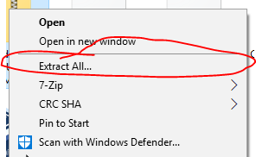
Step 3.5) Unzipping the Instance
Windows Users:
Right click on the zip file, and press “extract”
Mac Users:
I’m sure the Mac software automatically does it for you if you double click
If not, just right click it and “extract”
(I don’t have a apple computer so I can’t show you)

Slide 6
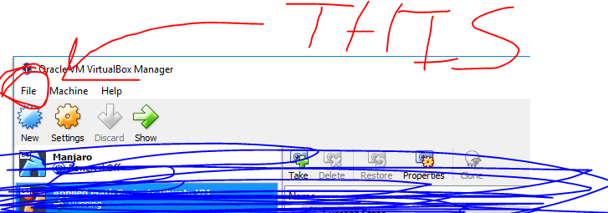
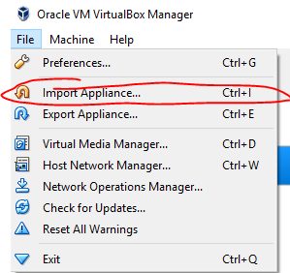
Step 4) Importing the Instance
Now we have:
VirtualBox Installed
A “Applied Math Projects Ubuntu VM.ova” file
Now we need to import the instance into our virtualbox
Click File -> Import Appliance (A window should pop up)
Or just “Ctrl + I” or “Cmd + I”

Slide 7
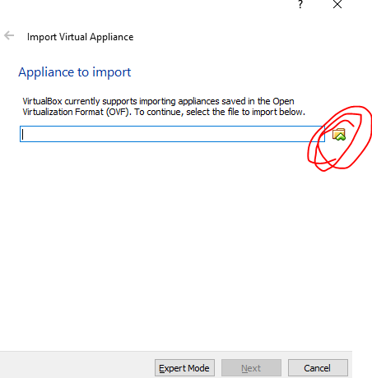
Step 5) Almost There
A Window like this (to your right) should pop up
Press the folder icon (or your apple equivalent) and put in the “Applied Math Projects Ubuntu VM.ova” file we unzipped earlier

Slide 8
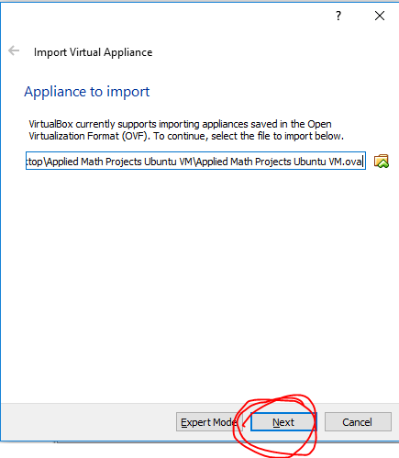
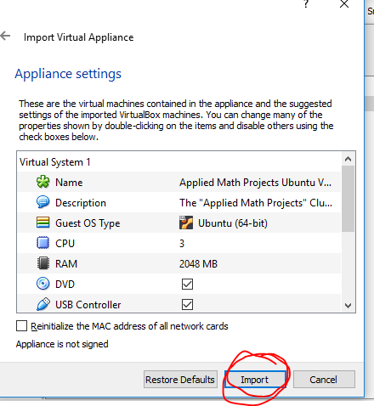
Step 5.5) Almost There
Click Next, and then Import
The importing process SHOULD take a long time

Slide 9
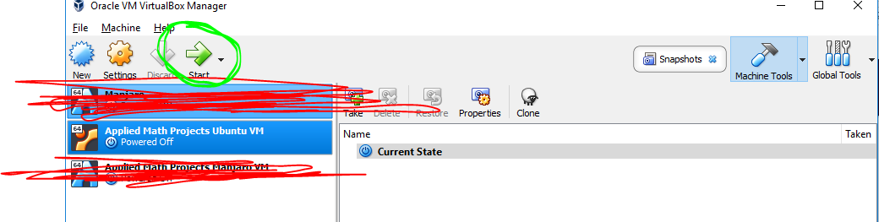
Step 6) Load up the VM
After you are done importing the Virtual Machine Image, something like this should be on your screen:
Click Start (Highlighted in green)
Booting should take a while, especially depending on the speed of your computer

Slide 10
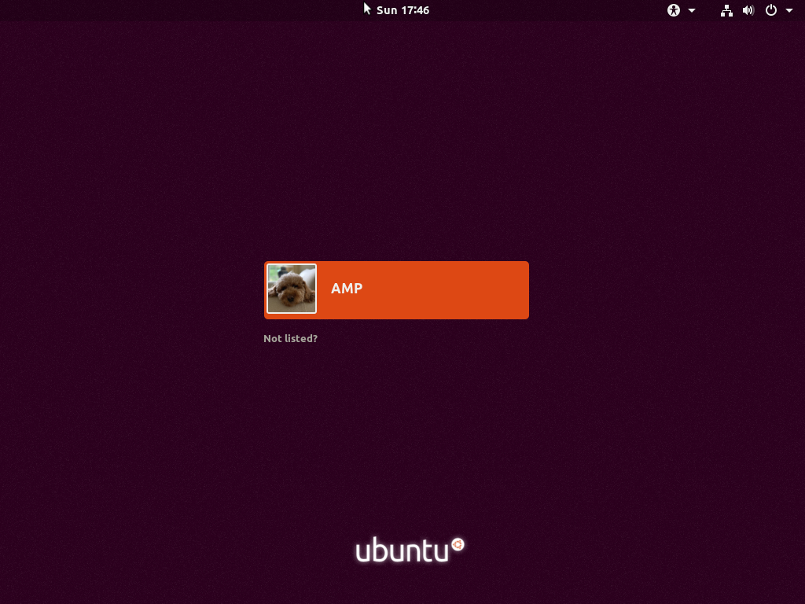
Step 7) Final Check
After your VM has started, you should be greeted with this screen
Click on the orange box and login
The password is “yeet”

Slide 11
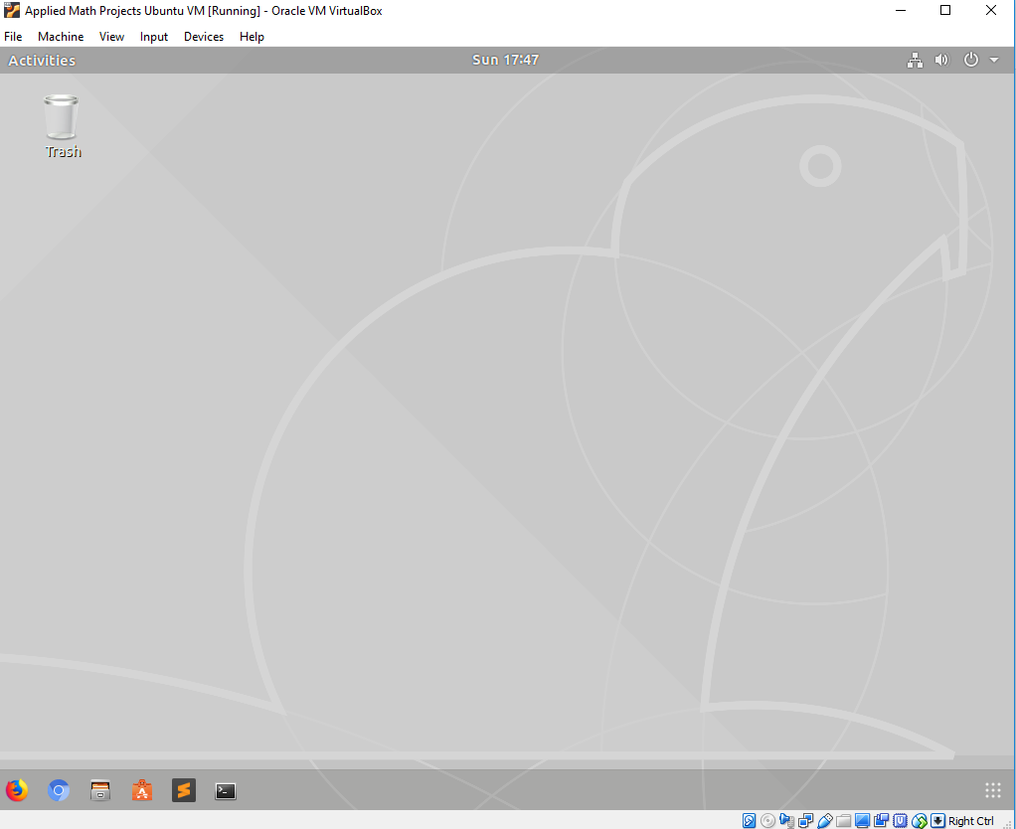
Step 7) Final Check
This should be your desktop
You are done (for now)

